Slide 1

Deep Learning Frameworks: TensorFlow vs PyTorch
By Judith Barrios
Notes:
Int

Slide 2

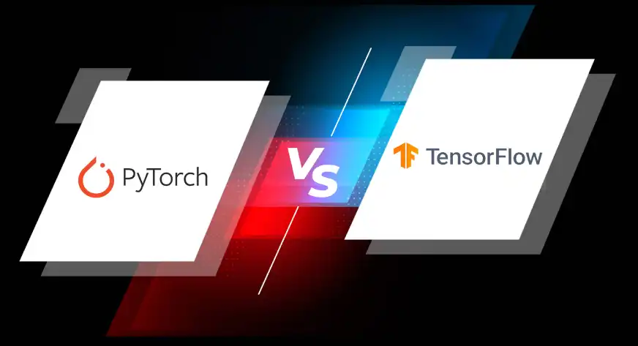
Introducing TensorFlow and PyTorch
Introduction to two leading machine learning frameworks
Explain why they matter in AI development
Overview of key areas of comparison
Notes:
Today, we will be comparing TensorFlow and PyTorch, two of the most widely used deep learning frameworks in the industry and academia. They each offer powerful tools for building, training, and deploying machine learning models. We will examine their background, features, use cases, and how they compare in real world performance and usability.

Slide 3

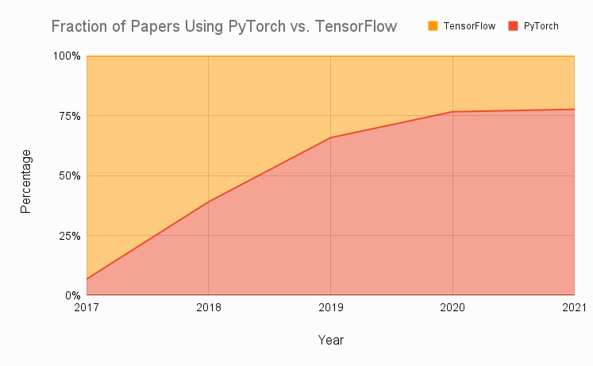
TensorFlow
TensorFlow
Created by Google Brain in 2015
Built for scalable machine learning and development
Originally used static graphs (evolved in TF 2.x)
PyTorch
Released by Facebooks AI Research in 2016
Focuses on research flexibility and dynamic computation
Built for easy prototyping with Python

Slide 4

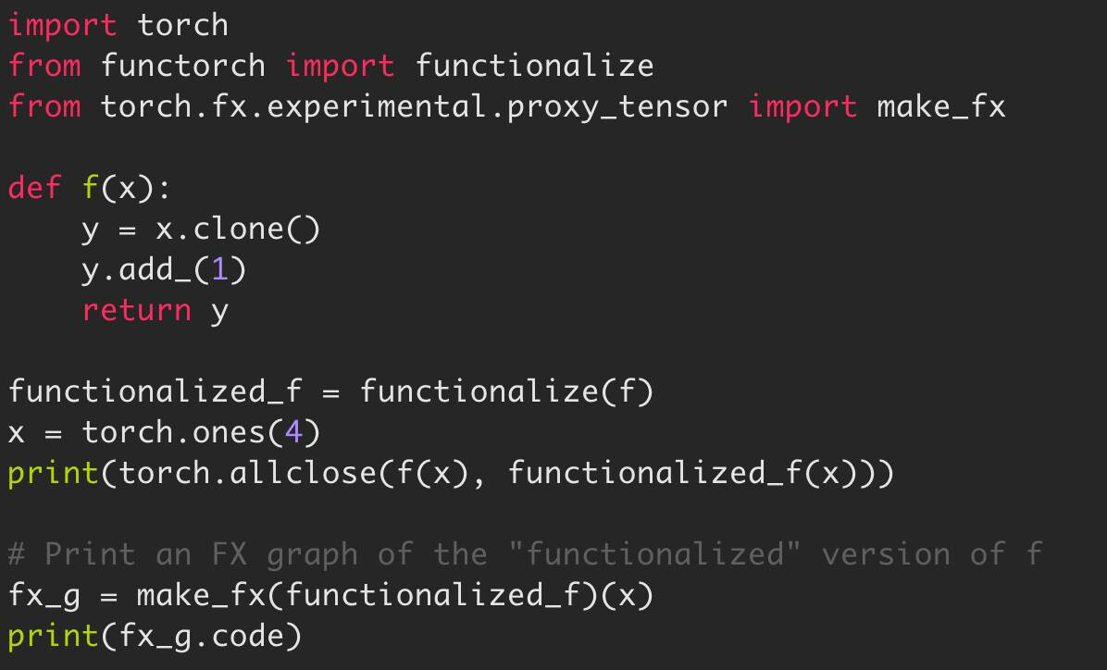
Key Features
TensorFlow
Static graphs (dynamic support in v2.x)
Keras API for high level model building
TensorBoard for training visualization
Broad deployment options: Lite, JS, Serving
Multi language support: Python, C++, JS
PyTorch
Dynamic graphs (eager execution)
Pythonic, easy to read syntax
Can integrate visualization tools like Weights and Biases
Deployable with TorchServe or ONNX
Supports fast debugging and flexible experimentation

Slide 5

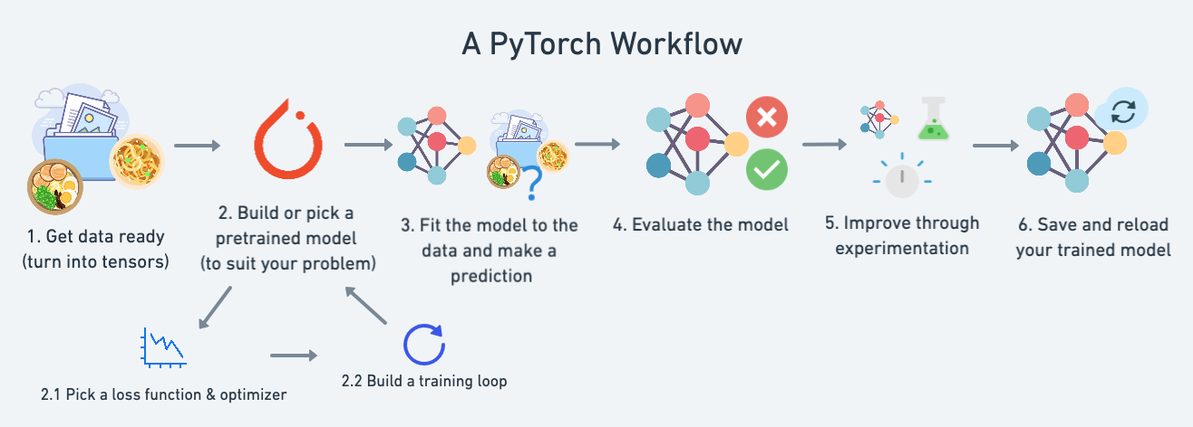
Real world applications
TensorFlow
Google Translate for real time multilingual NLP
Airbnb uses it for dynamic price prediction
Are put into mobile apps using Tensorflow Lite
PyTorch
Tesla Autopilot vision systems
Ubers Pyro probabilistic programming
Used in BERT, GPT-style models in NLP research

Slide 6

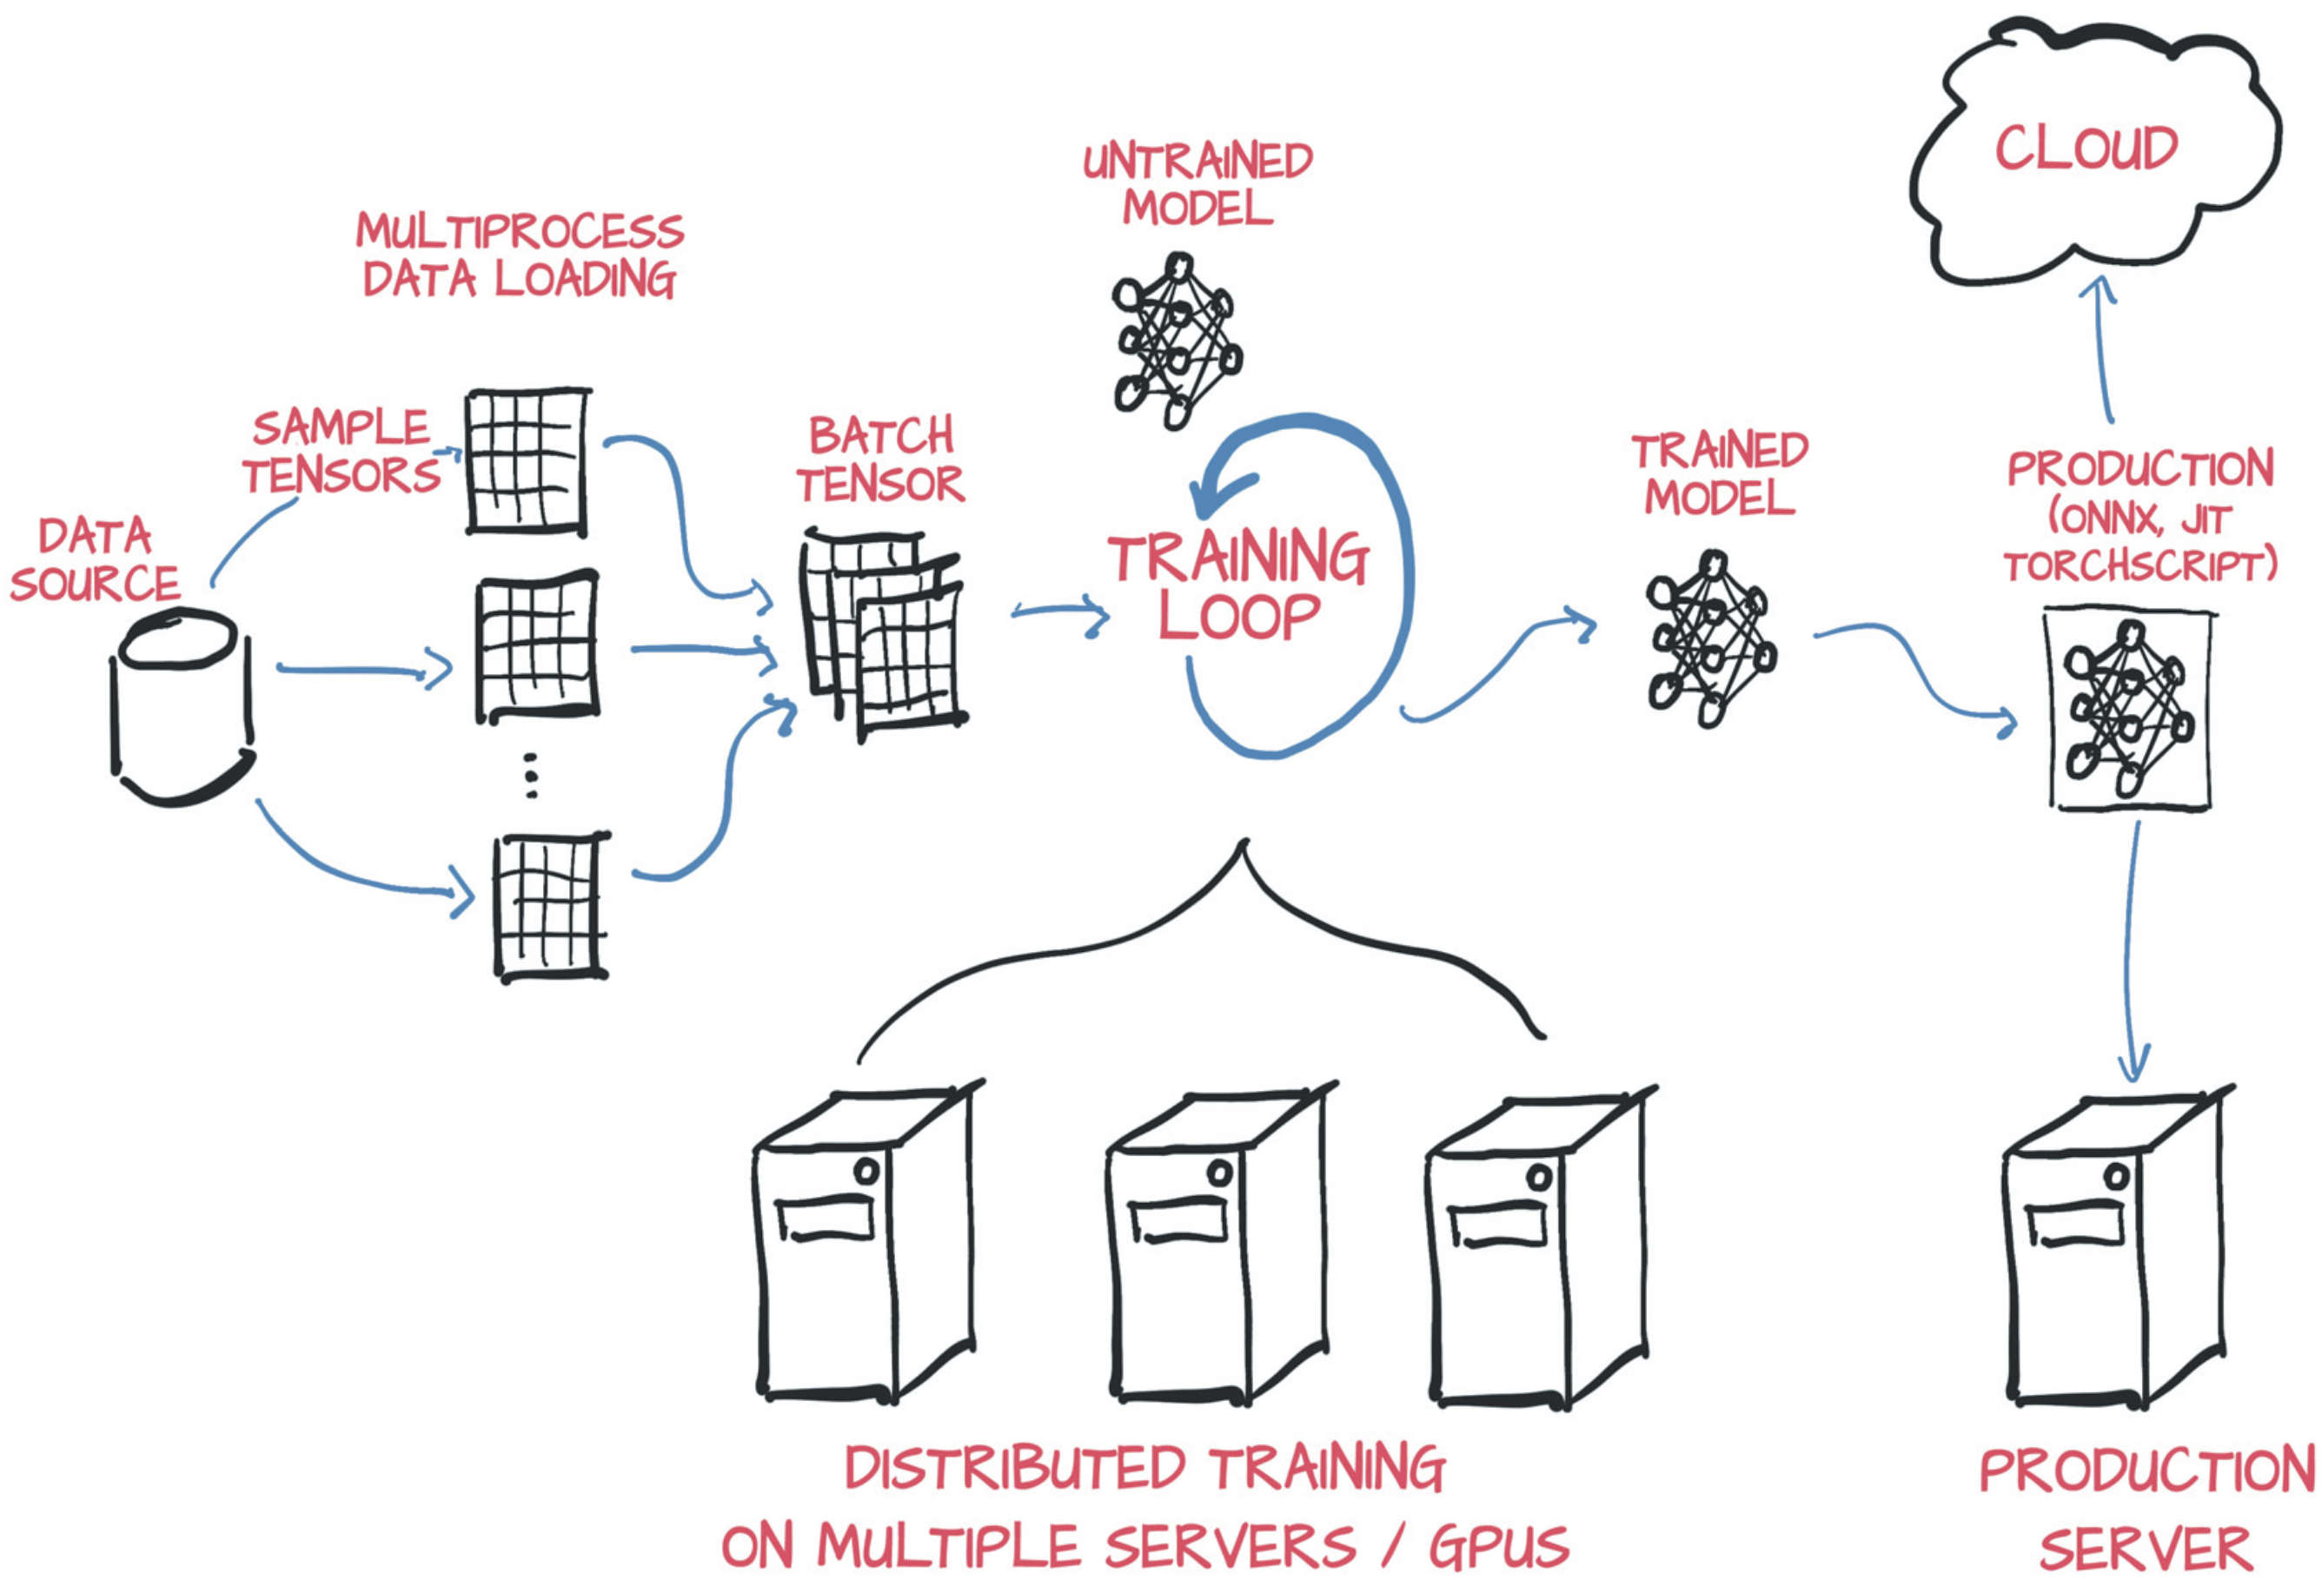
Comparative Perspective
Usability
TensorFlow: Steeper learning curve early on, simplified by Keras in v2.
PyTorch: Intuitive for Python users, minimal boilerplate code
Performance
TensorFlow: Fast and works well on big systems
PyTorch: Fast too, and easier to debug
Community and Help
TensorFlow: Lots of guides, backed by Google
PyTorch: Loved by students, teachers, and researchers
Scalability
TensorFlow: Works great in the cloud and on many devices
PyTorch: Good for small or big projects, flexible setup

Slide 7

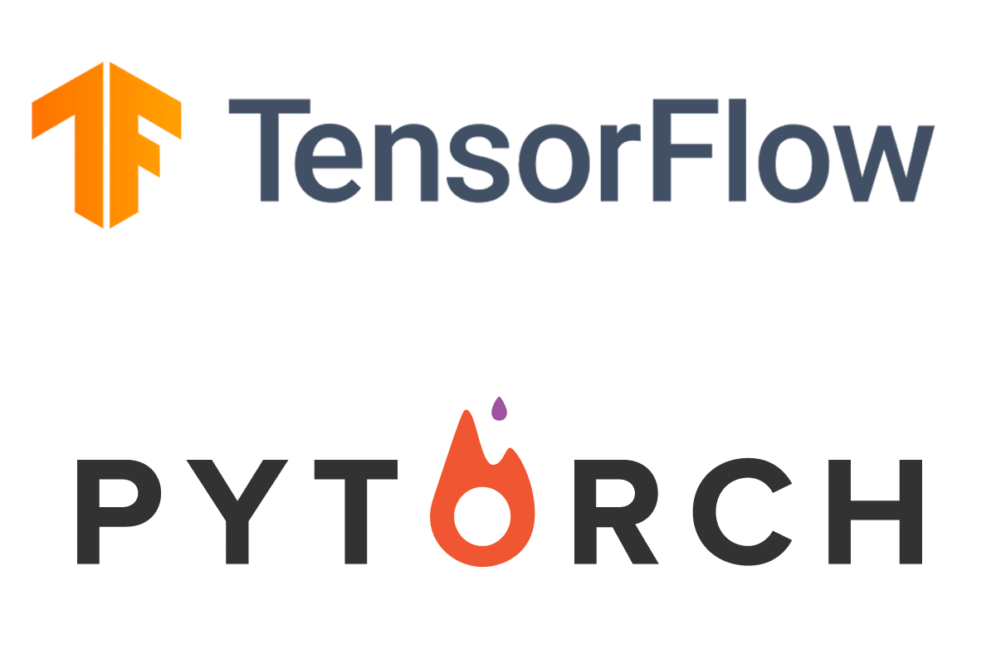
Final Thoughts
TensorFlow is best for apps that need to run at scale
PyTorch is better for fast testing and research work
Use what fits your project best

Slide 8

Sources
https://www.trustradius.com/compare-products/jupyter-notebook-vs-pytorch#:~:text=Pytorch%20is%20very%2C%20very%20simple,around%20with%20the%20loss%20functions.
https://www.assemblyai.com/blog/pytorch-vs-tensorflow-in-2023
https://docs.rafay.co/blog/2024/09/16/pytorch-vs-tensorflow-a-comprehensive-comparison-in-2024/

